Slide 1
CO 2
Session no. 17

Slide 2
Types of Routing
Routing is a process which is performed by layer 3 (or network layer) devices in order to deliver the packet by choosing an optimal path from one network to another.
There are 3 types of routing:
Static Routing
Default routing
Dynamic routing

Slide 3
Static routing
Static routing is a process in which we have to manually add routes in routing table. Advantages
No routing overhead for router CPU which means a cheaper router can be used to do routing.
It adds security because only administrator can allow routing to particular networks only.
No bandwidth usage between routers.
Disadvantage
For a large network, it is a hectic task for administrator to manually add each route for the network in the routing table on each router.
The administrator should have good knowledge of the topology. If a new administrator comes, then he has to manually add each route so he should have very good knowledge of the routes of the topology.

Slide 4
Default routing
This is the method where the router is configured to send all packets towards a single router (next hop). It doesn’t matter to which network the packet belongs, it is forwarded out to router which is configured for default routing. It is generally used with stub routers. A stub router is a router which has only one route to reach all other networks.

Slide 5
Dynamic routing
Dynamic routing makes automatic adjustment of the routes according to the current state of the route in the routing table. Dynamic routing uses protocols to discover network destinations and the routes to reach it. RIP and OSPF are the best examples of dynamic routing protocol. Automatic adjustment will be made to reach the network destination if one route goes down.
A dynamic protocol have following features:
The routers should have the same dynamic protocol running in order to exchange routes.
When a router finds a change in the topology then router advertises it to all other routers.

Slide 6
Dynamic routing (continued)
Advantages –
Easy to configure.
More effective at selecting the best route to a destination remote network and also for discovering remote network.
Disadvantage –
Consumes more bandwidth for communicating with other neighbors.
Less secure than static routing.

Slide 7
Unicast Routing Protocols: RIP, OSPF, and BGP
Objectives
Upon completion you will be able to:
Distinguish between intra and interdomain routing
Understand distance vector routing and RIP
Understand link state routing and OSPF
Understand path vector routing and BGP

Slide 8
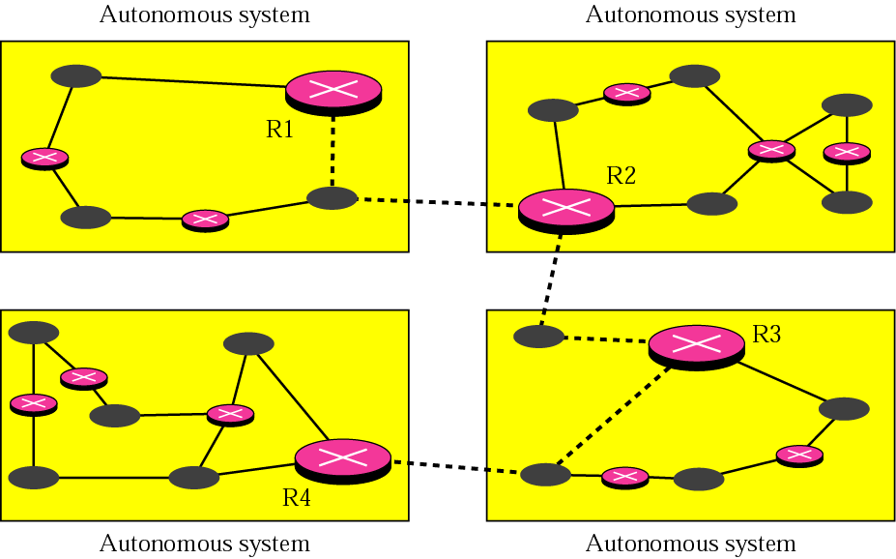
INTRA- AND INTERDOMAIN ROUTING
Routing inside an autonomous system is referred to as intradomain routing. Routing between autonomous systems is referred to as interdomain routing.
Fig. Autonomous system

Slide 9
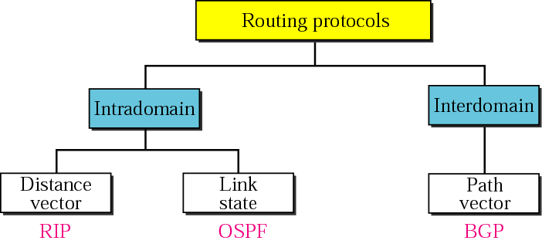
Popular routing protocols

Slide 10
DISTANCE VECTOR ROUTING
In distance vector routing, the least cost route between any two nodes is the route with minimum distance. In this protocol each node maintains a vector (table) of minimum distances to every node
The topics discussed in this section include:
Initialization
Sharing
Updating
When to Share

Slide 11
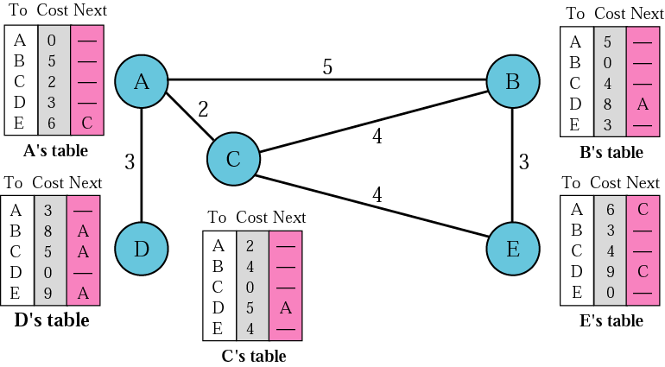
Figure. Distance vector routing tables

Slide 12
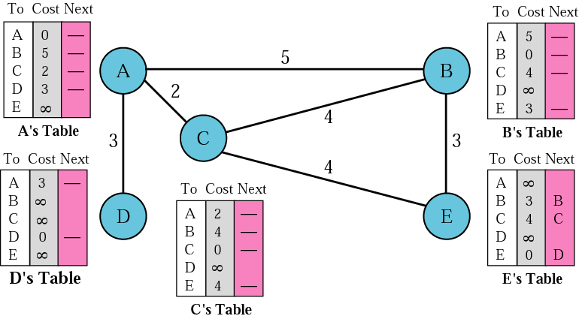
Figure. Initialization of tables in distance vector routing

Slide 13
Note:
In distance vector routing, each node shares its routing table with its immediate neighbors periodically and when there is a change.

Slide 14
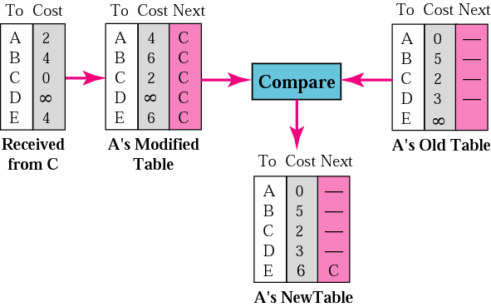
Figure. Updating in distance vector routing

Slide 15
RIP
The Routing Information Protocol (RIP) is an intradomain routing protocol used inside an autonomous system. It is a very simple protocol based on distance vector routing.
The topics discussed in this section include:
RIP Message Format
Requests and Responses
Timers in RIP
RIP Version 2
Encapsulation

Slide 16
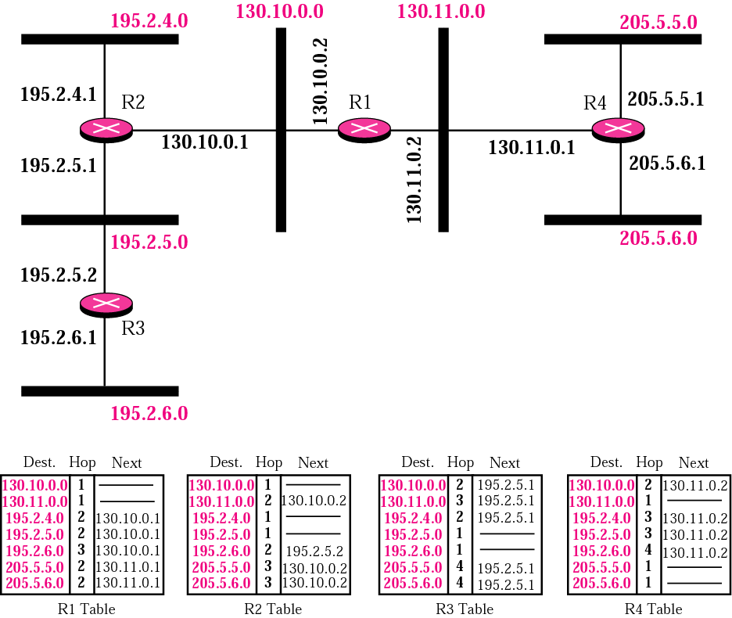
Figure. Example of a domain using RIP

Slide 17
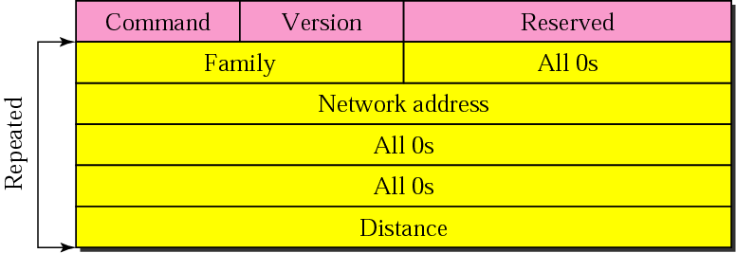
Figure. RIP message format

Slide 18
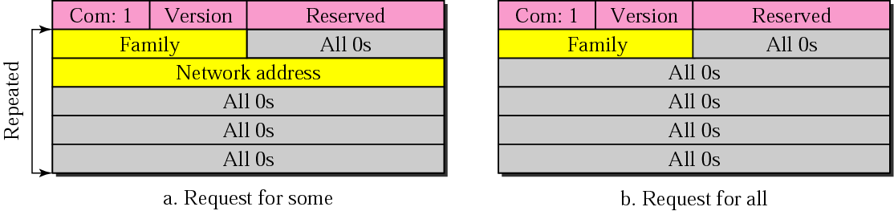
Figure. Request messages

Slide 19
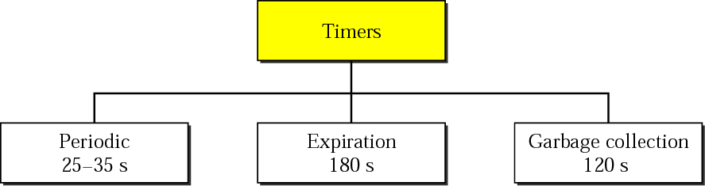
Figure. RIP timers

Slide 20
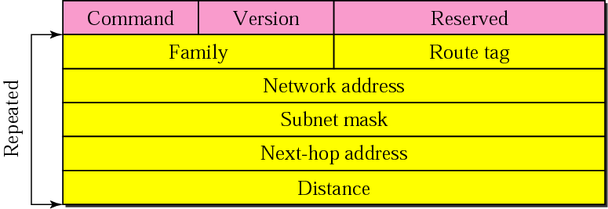
Figure. RIP version 2 format

Slide 21
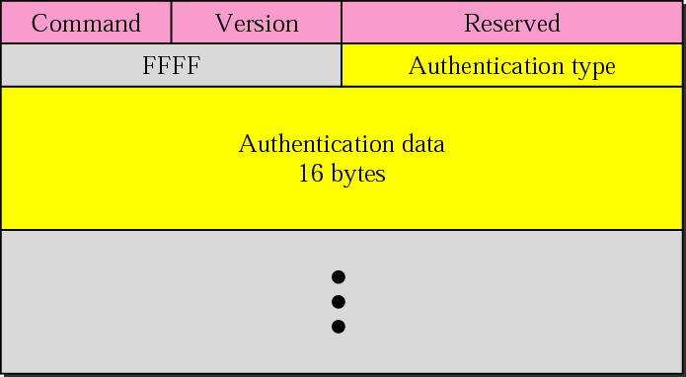
Figure. Authentication

Slide 22
Note:
RIP uses the services of UDP on well-known port 520.

